Slide 1
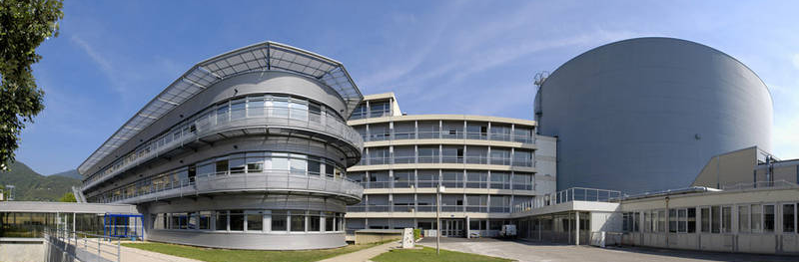
Current implementation and future plans at the ILL
Dr Ian Bush

Slide 2

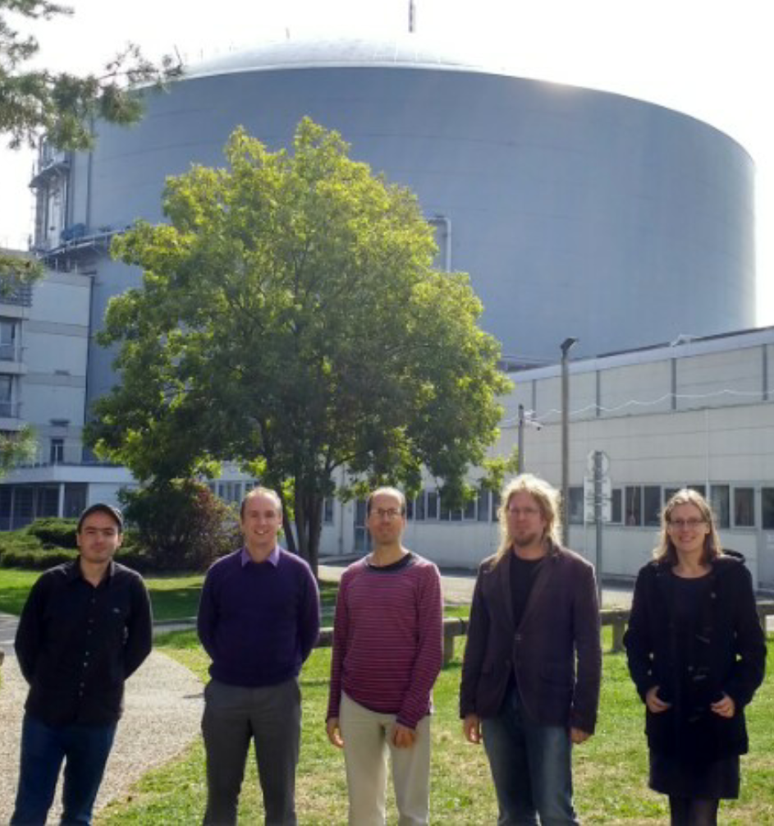
Bastille Project
Started May 2016
Bastille project to support 20 ILL instruments after 3 years
Mantid for shared effort and common user experience
Developers
Antti Soininen, Verena Reimund, Gagik Vardanyan
Ian Bush – technical lead for two years – from Tessella
Miguel González – scientific lead for the project – from ILL’s CS Group
Notes:
Been going for one year.
Mantid chosen for a number of reasons, existing LAMP software had main developer retiring, something common across facilities, shared effort.

Slide 3
General ILL Requirements
Requirement | Progress
Data merging | New features to allow merging where a run spans multiple files
Detector scans | Advanced progress, loader for D2B instrument scans
GUI | Plans to begin with a new GUI for Time-of-Flight Spectroscopy, common widgets and look and feel
Mantid v4 | Planned contribution starting September 2017
Mantid user training | End of 2017
Event mode data | Planned to address in 2017/2018
BLOSC Compression | Planned to address in 2017/2018
Auto-reduction | Working with SCI group to plan to move towards this
Live data | Working with SCI group to plan to move towards this

Slide 4
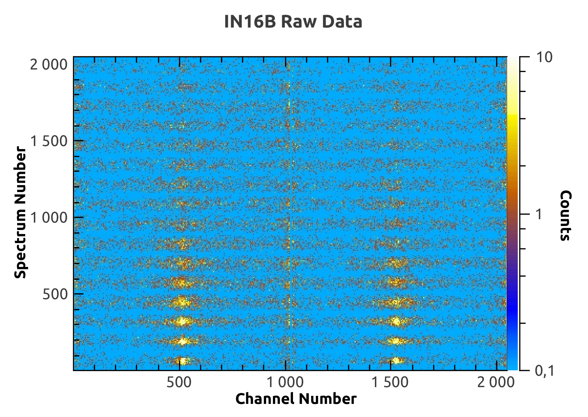
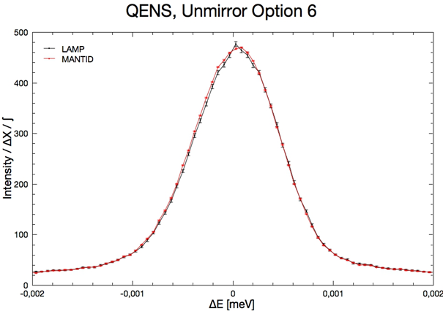
Backscattering (IN16B)
IndirectILLEnergyTransfer
Starting point was initial work done by Spencer Howells & Co.
Implementation of LAMP ‘unmirroring’ options
IndirectILLReductionQENS
IndirectILLReductionFWS
Notes:
Critical requirement was multiple file handling - ~1000 for FWS
Automatic handling of different data and reduction types
In use on instrument, good feedback, happy instrument scientists.
GUI extended on what was before.

Slide 5
Instruments to Support
Technique | Instruments | Progress
Backscattering Spectroscopy | IN16B | Included in v3.9, tested and in use on instrument
Time-of-Flight Spectroscopy | IN4, IN5, IN6 | Being tested by instrument scientists, aim to complete for October 2017
Reflectometry | D17 and Figaro | Data loading and IDFs, aim for use in October 2017
Powder Diffraction | D20, D2B, D1B and D4C | Data loading and IDFs, workflow started, aim for use in October 2017
Liquid Diffraction | D4, SALSA | To start in 2018
SANS | D11, D22, D33 | To start in September 2017
Other | D7, D16, LAGRANGE | As required

Slide 6
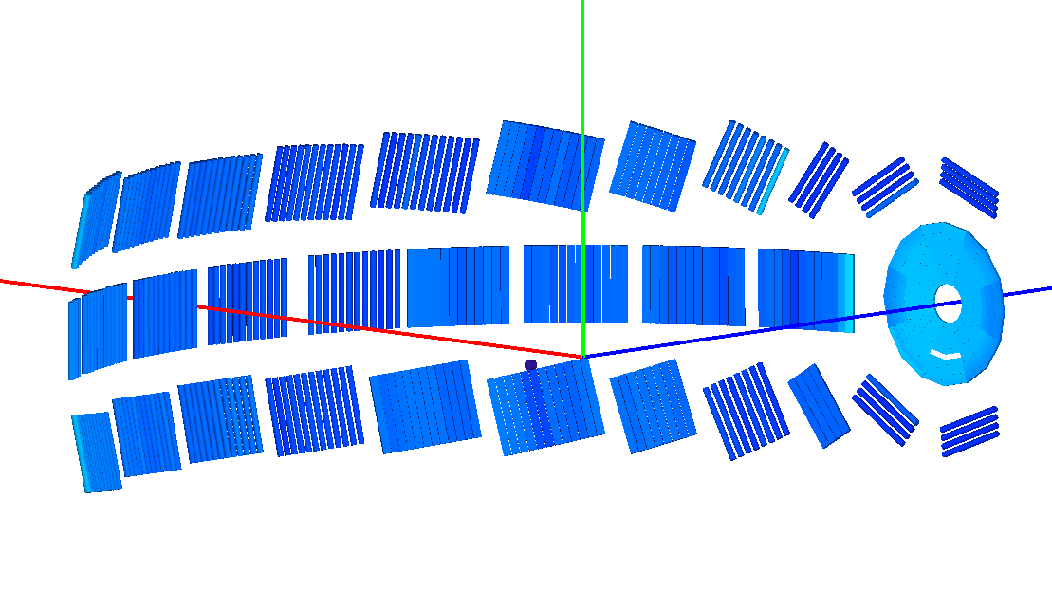
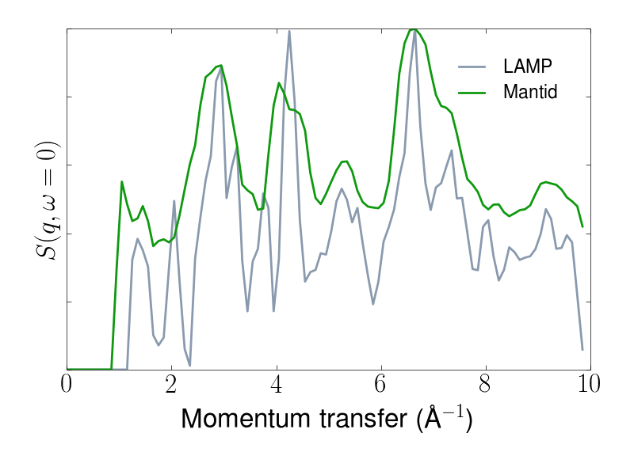
Time-of-Flight Spectroscopy
Full instrument geometry used in Mantid, in LAMP only detector angles used
Some ILL specific issues
Incident energy calibration
Arbitrary ToF delay – need to fit elastic peak
Monte-carlo absorption simulation for IN5
Result seem to match LAMP
Notes:
Things for free, full S(Q,w), detector diagnostics, better plotting.
Again, happy instrument scientists, results make sense when compared to LAMP. Goes beyond LAMP in many areas, and instrument scientists happy with the workflow approach which gives allows for flexible scripting. GUI to come.

Slide 7
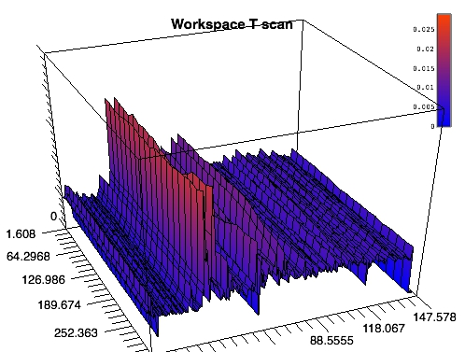
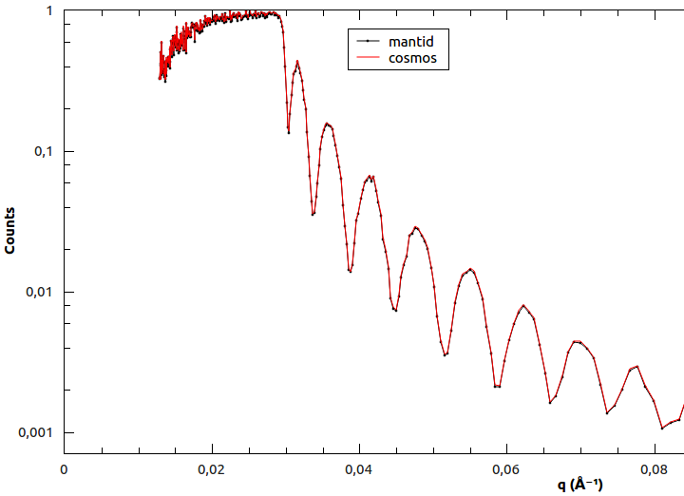
Reflectometry, Powder Diffraction
Reflectometry – Data loading for D17 and Figaro
Powder Diffraction – Work started for D20 (temperature scans) and D2B (detector scans)
Notes:
Reflectometry and powder diffraction started, some basic loading and treatment, along with instrument definitions, has been started.

Slide 8
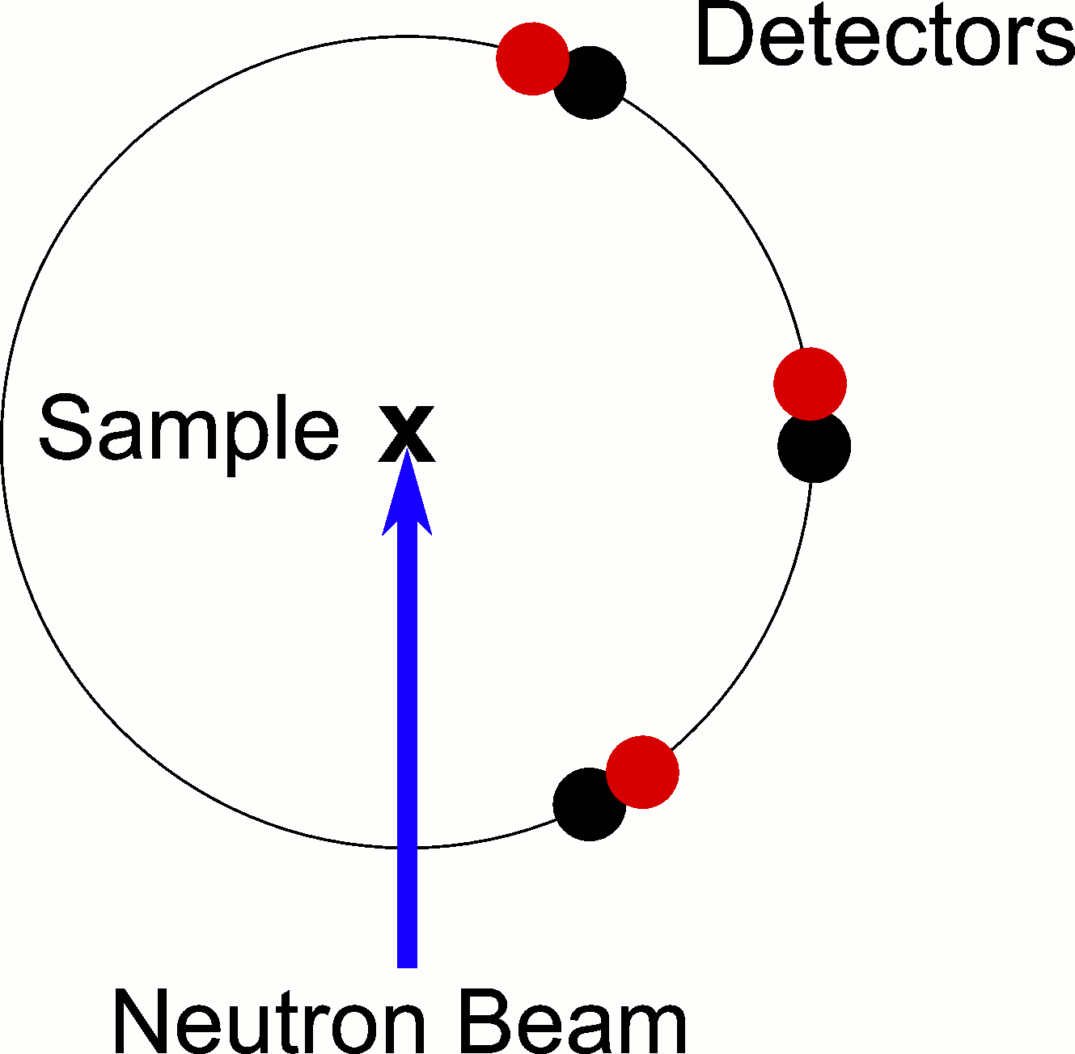
Detector Scans
Challenge facing the ILL at start of the project was to support detector scans
Key framework changes made in conjunction with Instrument 2.0 work at the ESS
Basic data loading for D2B implemented, some further work to fully support detector scans
Notes:
This was one of the challenges for the ILL – some instruments move to perform a scan during their run, and supporting these in Mantid was required. This coincided with the work Simon and Owen at the ESS were doing for a new Instrument design in Mantid. We now have the framework changes in place to support such scans, though we still need some work to fully support everything.

Slide 9
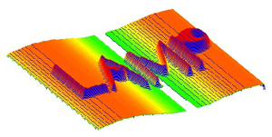
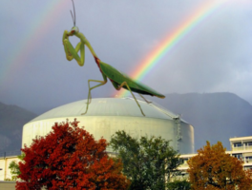
Challenges Ahead for the ILL
Workflows for reflectometry, powder diffraction, liquid diffraction and SANS
Support during next instrument cycle for ToF Spectroscopy and Backscattering – any issues?
GUIs for ILL workflows with a common look and feel
Detector scan functionality in a full workflow
Providing a better user experience – autoreduction and live data

